Slide 1

Hand Sign Recognition Using LENet Like Architecture

Slide 2
Objective
The main objective of this research is to contribute to the field of automatic sign language recognition by creating a convolutional neural network classifier that can recognize sign language with high accuracy, using vision-based approaches.
The secondary objective is to help and facilitate vocal disabled people to communicate with the outside world.

Slide 3
Introduction
Sign language is most imperative for every people who have facing hearing and speaking deficiency, generally it’s called Deaf-Mute.
Only mode of communicating for such peoples for conveying their messages and this become essential for the people to understand their languages
To initiate interaction and communication with Deaf-Mute peoples for absolute importance nowadays for minimizing their isolation in the society.
There are so many signs which expressing the complex meaning and recognize them is a challenging task for people who have no understanding of sign languages.
Due to their inability to talk and hear, most of deaf-mute people remain unemployed.

Slide 4
Introduction (Cont.…..)
Most research and developments focus on verbal language translation and this puts the deaf and mute community at a disadvantage.
Therefore, there is a need for a sign language recognition system, which would convert standard sign language to text, and then perhaps text to speech.
Glove-based approaches have been more accuracy in gesture recognition but they were quite costly and inconvenient to the user whereas vision-based methods provide more user convenience and are cost-effective

Slide 5
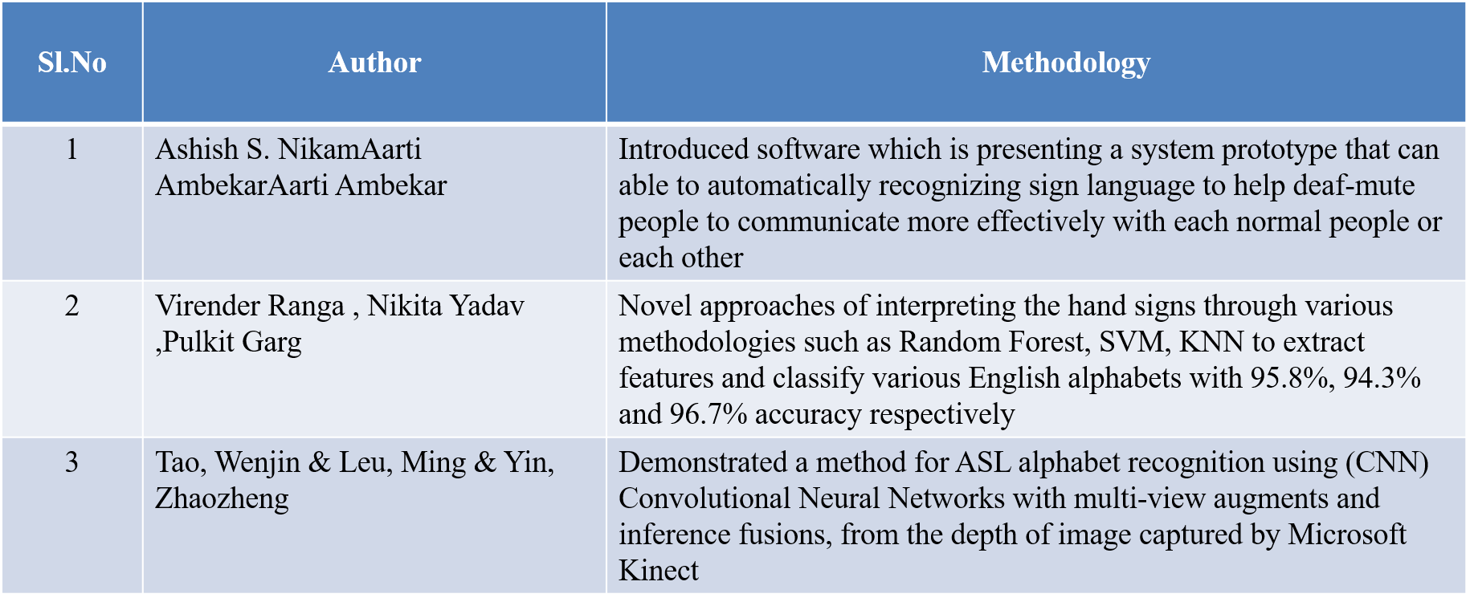
Literature Review

Slide 6
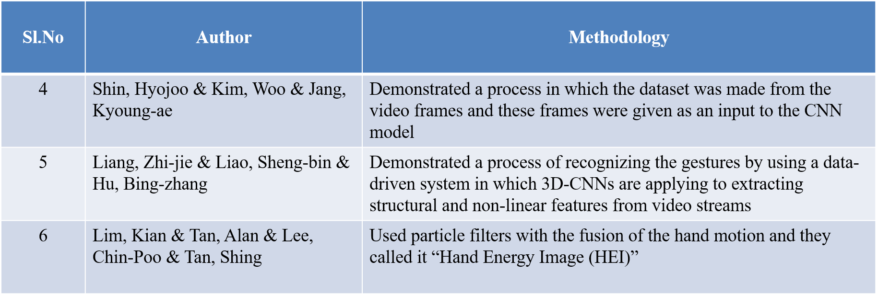
Literature Review (Cont…)

Slide 7
Dataset Description
MNIST (Modified National Institute of Standards and Technology) is a dataset of handwritten digits. It consists of 70,000 grayscale images of digits from 0 to 9.
J and Z need motion in sign language. We are experimenting only for image data set only. So, we exclude J and Z.
MNIST sign language (American sign language) data set were chosen to train and test our model . In MNIST sign language data set contain 34,627 images which are made as 24 classes of alphabets exclude J and Z .
Training Set: 60,000 images Test Set: 10,000 images Each image is a 28x28 pixel square (784 pixels total).

Slide 8
Data Collection
Data collection is the initial step of this method
We refer to 8 countries (USA, India, Germany, Poland, Argentina, turkey, China, Arabia) sign languages different 20 data sets.
We analyzed among the data set which will suitable for the deep learning model and we finalize MINST sign language data set to train and test our model.

Slide 9
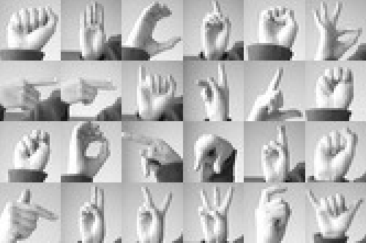
MNIST Sign Language Data Set Sample Images

Slide 10
Data Augmentation
After data selection, we need to upload our data to our model. But still, we have a problem that convolution neural network will not care about rotation of different angles. In our case, we are working in real-time data where disable people will communicate through sign language but we can’t expect the same angle will show by people.
Even though we are having different angle images in the data set to get more accuracy we are augmenting the image with different angles. This position augmentation will help to predict the hand sign at any angle or direction.

Slide 11
Data Augmentation techniques that we have used
1. Color Jitter:
-Brightness, contrast, saturation, and hue: Varying these parameters can account for different lighting conditions and skin tones.
2. Noise Addition:
-Gaussian noise or salt-and-pepper noise: Introducing noise can simulate real-world image degradation.
3. Elastic Transformations:
-Non-linear deformations: Applying elastic transformations can introduce realistic distortions that mimic variations in hand shape and pose.
4. Occlusion:
-Partial occlusion: Simulating partial occlusion can handle cases where parts of the hand are obscured.

Slide 12
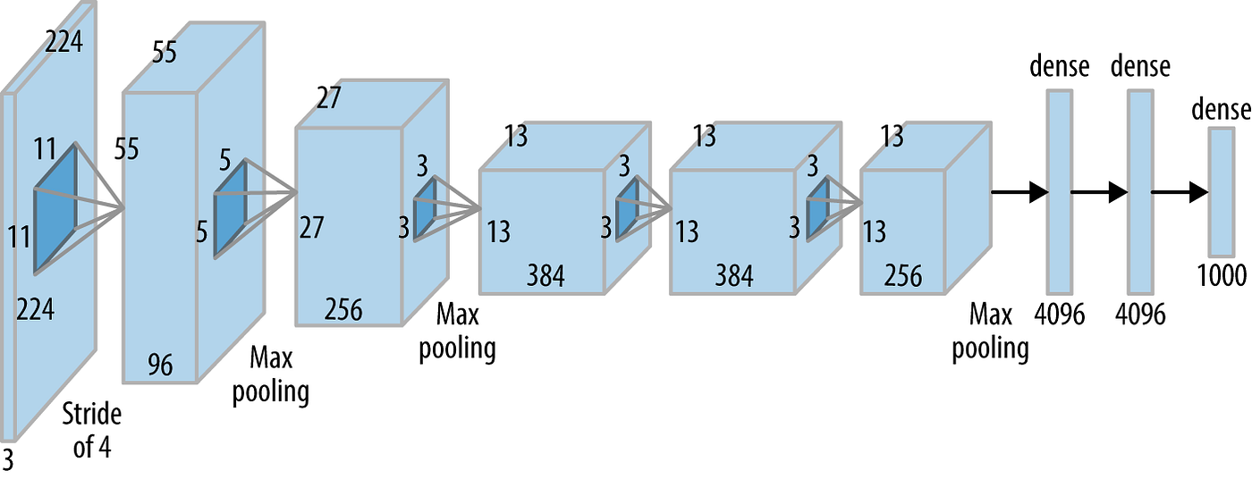
LeNet like Architecture Layers Sequence

Slide 13
[Input Image]
↓
[Conv Layer 1 (Conv + ReLU + Max Pool)]
↓
[Conv Layer 2 (Conv + ReLU + Max Pool)]
↓
[Conv Layer 3 (Conv + ReLU)]
↓
[Conv Layer 4 (Conv + ReLU)]
↓
[Conv Layer 5 (Conv + ReLU + Max Pool)]
↓
[Flatten]
↓
[Fully Connected Layer 1 (FC + ReLU)]
↓
[Fully Connected Layer 2 (FC + ReLU)]
↓
[Output Layer (SoftMax)]

Slide 14
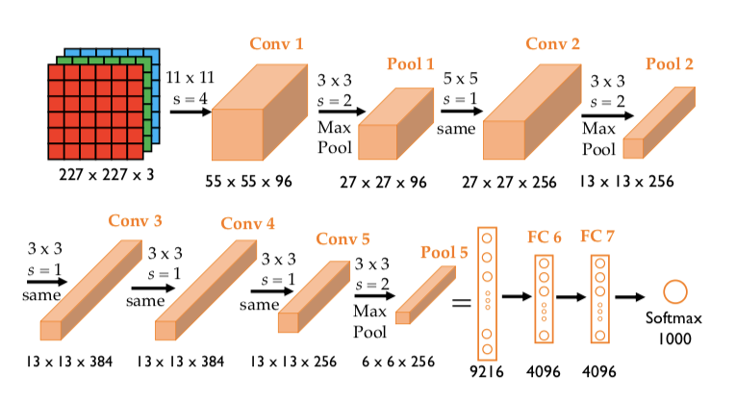
LeNet like Architecture

Slide 15
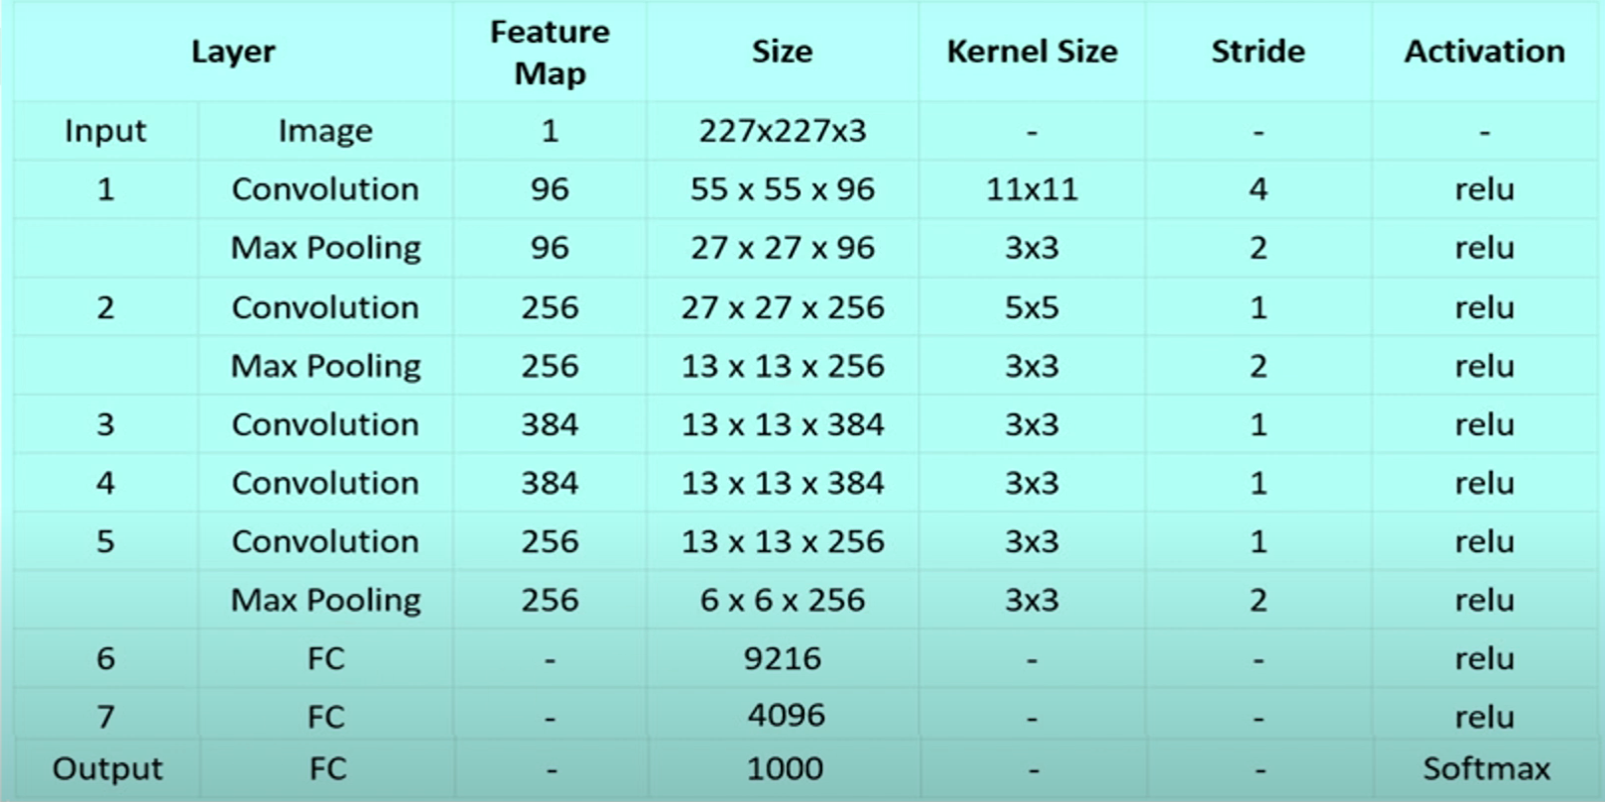
Dimension and details

Slide 16
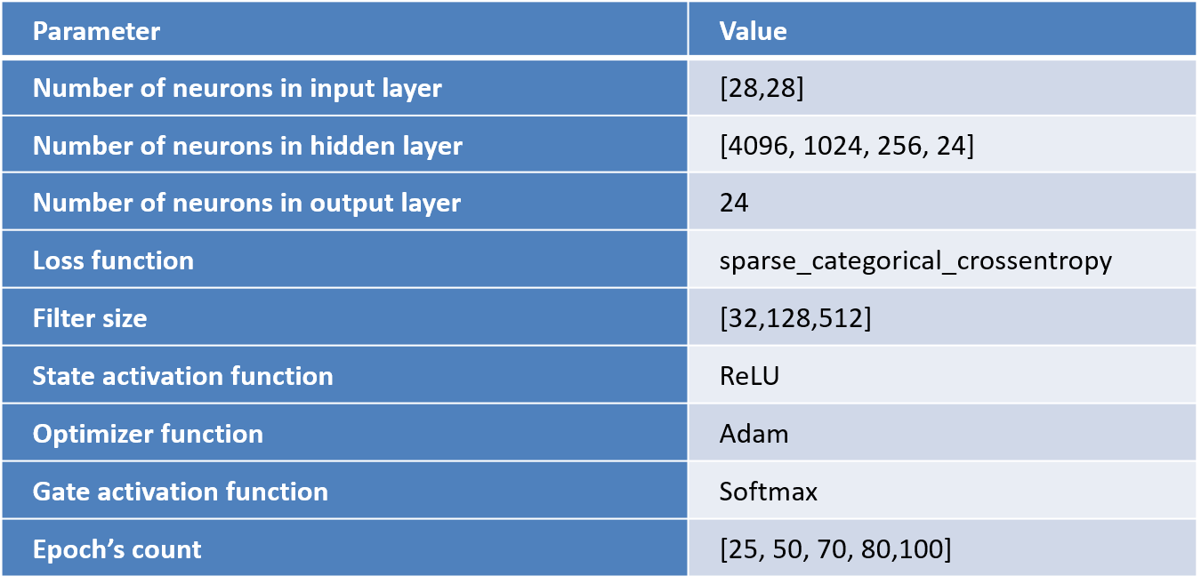
Parameter Settings

Slide 17
LeNet like architecture
Input: 227x227x3 RGB images.
Convolutional Layers:
5 convolutional layers with varying filter sizes (e.g., 55x55, 27x27, 13x13).
Each convolutional layer is followed by a ReLU activation function.
Max-pooling layers follow some convolutional layers to downsample the feature maps.
Fully Connected Layers:
After convolutional layers, the feature maps are flattened and passed through 3 fully connected layers (4096 neurons in the first two, 1000 in the last for classification).
The final layer uses a SoftMax activation for classifying 1000 classes.
Dropout: Applied after fully connected layers to prevent overfitting by randomly turning off some neurons during training.
Local Response Normalization (LRN): Helps in normalizing feature maps and enhancing generalization.

Slide 18
Training Lenet like Architecture
1.Prepare your dataset: Gather images and labels for your training and testing sets. Ensure they're in a suitable format. The dataset that we have used is MNIST.
2.Define the architecture: Create a neural network model with the following layers:
Convolutional layers: Apply filters to extract features from the images.
Pooling layers: Downsize the feature maps to reduce computational cost.
Fully connected layers: Combine features and classify the images.
SoftMax layer: Output probabilities for each class.
3.Compile the model: Choose an optimizer to update weights during training and a loss function (e.g., sparse categorical cross-entropy) to measure the model's error.
4.Train the model: Feed the training data into the model and adjust weights iteratively using backpropagation.
5.Evaluate the model: Use the test set to assess the model's performance on unseen data. Calculate metrics like accuracy, precision, recall, and F1-score

Slide 19
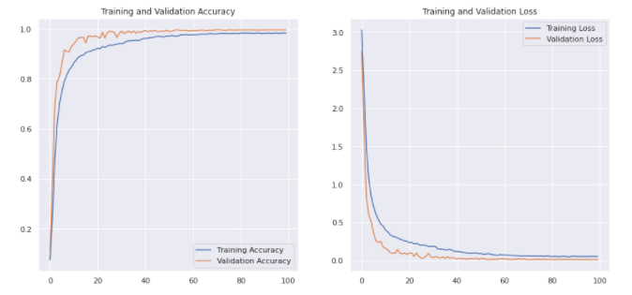

Slide 20
Testing and Validation
Alphabet | Precision | Recall | F1 Score | Support
A | 1.00 | 1.00 | 1.00 | 416
B | 1.00 | 1.00 | 1.00 | 565
C | 1.00 | 1.00 | 1.00 | 299
D | 1.00 | 1.00 | 1.00 | 254
E | 1.00 | 1.00 | 1.00 | 457
F | 1.00 | 1.00 | 1.00 | 247
G | 1.00 | 1.00 | 1.00 | 231
H | 1.00 | 1.00 | 1.00 | 493
I | 1.00 | 1.00 | 1.00 | 505
K | 1.00 | 1.00 | 1.00 | 307
L | 1.00 | 1.00 | 1.00 | 207
M | 1.00 | 1.00 | 1.00 | 357
N | 1.00 | 1.00 | 1.00 | 273
O | 1.00 | 1.00 | 1.00 | 265
P | 1.00 | 1.00 | 1.00 | 274
Q | 1.00 | 1.00 | 1.00 | 221
R | 0.99 | 1.00 | 1.00 | 120
S | 1.00 | 1.00 | 1.00 | 217
T | 1.00 | 0.95 | 0.98 | 204
U | 0.99 | 1.00 | 1.00 | 170
V | 1.00 | 1.00 | 1.00 | 116
W | 1.00 | 1.00 | 1.00 | 441
X | 0.96 | 1.00 | 0.98 | 229
Y | 1.00 | 1.00 | 1.00 | 331
accuracy |  |  | 1.00 | 7172
macro avg | 1.00 | 1.00 | 1.00 | 7172
weighted avg | 1.00 | 1.00 | 1.00 | 7172

Slide 21
Comparison with Another Model
Authors(s) | Publication Year | Dataset | Model | Accuracy
Virender Ranga et al. | 2018 | ASL Dataset | Random Forest, SVM, KN | 97.01
Wenjin Taoa et al | 2018 | ASL alphabet dataset | Convolutional neural network with multi view augmentation | 99.4
Hyojoo Shin et al | 2019 | Korean Sign language dataset | Support vector machine | 84.5
Zhi-jie Liang et al | 2018 | SLVM | 3D CNN | 89.2
Kian Ming Lim et al | 2019 | Annotated hand dataset | CNN | 95.6
Proposed Model | - | MNIST hand sign dataset | LeNet like Architecture | 99.59

Slide 22
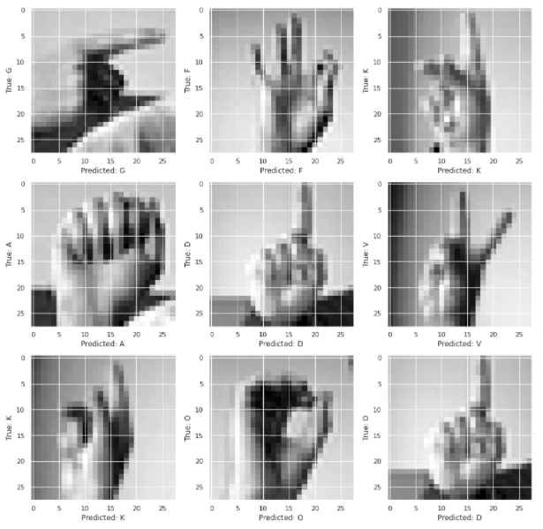
Testing Sample Images

Slide 23
Conclusion and Future work
We discussed the sign language and drawbacks of sign language. The various recent research article has reviewed with advantage and disadvantage.
From that analysis of various models we designed LeNet like a model with a combination of conv , max pool, dropout, dense layer.
To avoid over fitting dropout layer has been added in different places which gives the best result. We trained our model with different epoch and the result has registered in our article.
Our methodology LeNet like architecture recognizing 24 different hand signs in order to reduce the communication gap between the normal and deaf and dumb people.
We trained our LeNet like a model and got an accuracy of 99.60%. the accuracy which we got is really acceptable. And still, we are working to improve our model to the next level.
In the future, we will try to incorporate this algorithm in a mobile application so that people can directly use them as much as possible

Slide 24
References
ASL Alphabet Image data set for alphabets in the American Sign Language , https://www.kaggle.com/grassknoted/asl-alphabet
A. Das, S. Gawde, K. Suratwala and D. Kalbande,(2018) "Sign Language Recognition Using Deep Learning on Custom Processed Static Gesture Images," 2018 International Conference on Smart City and Emerging Technology (ICSCET), pp. 1-6, doi: 10.1109/ICSCET.2018.8537248
Andrew G. Howard, Menglong Zhu, Bo Chen, Dmitry Kalenichenko, Weijun Wang, Tobias Weyand, Marco Andreetto, Hartwig Adam,(2017) MobileNets: Efficient Convolutional Neural Networks for Mobile Vision Applications, https://arxiv.org/abs/1704.04861, .
Christian Szegedy,Wei Liu, Yangqing Jia, Pierre Sermanet, Scott Reed, Dragomir Anguelov, Dumitru Erhan, Vincent Vanhoucke, Andrew Rabinovich,(2014) Going Deeper with Convolutions, https://arxiv.org/abs/1409.4842,.
Becky Sue Parton(2005). “Sign language recognition and translation: A multidisciplined approach from the field of artificial intelligence”.Journal of deaf studies and deaf education, 11(1):94–101
Mukul Singh Kushwah, Manish Sharma, Kunal Jain, and Anish Chopra(2017)“Sign language interpretation using pseudo glove”. In Proceeding of International Conference on Intelligent Communication, Control and Devices, pages 9–18. Springer, 2017
Joze, H.R.V., Koller, O.(2018) MS-ASL: A Large-Scale Data Set and Benchmark for Understanding American Sign Language. arXiv 2018, arXiv:1812.01053
Cui. R., Liu H., Zhang. C.(2019) A deep neural framework for continuous sign language recognition by iterative training. IEEE Trans.Multimed. 21, 1880–1891

Slide 25

Thank You

